Slide 1

“Social Engineering: The Art of Human Hacking” - the book that reveals and dissects the technical aspect of many social engineering maneuvers.​ It contains many physical and mental techniques used by social engineers around the world

Slide 2
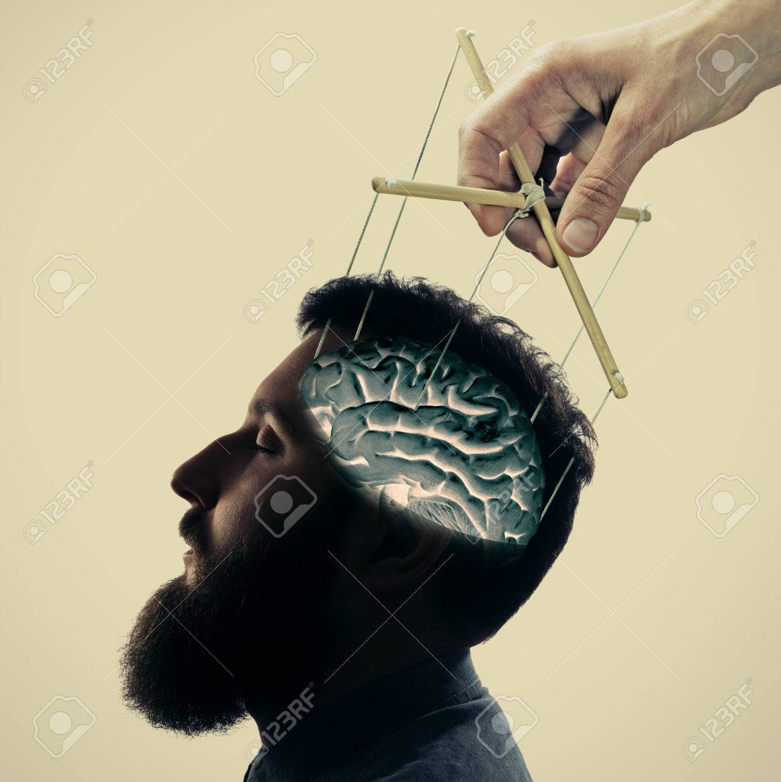
Mind tricks: rapport Ability to manipulate consciousness - the skills that play a key role in the work of a social engineer.

Slide 3
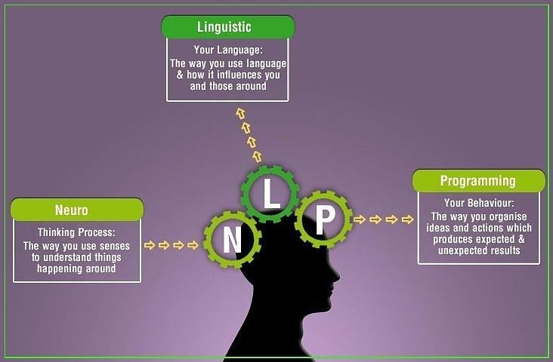
No less efficient is neurolinguistics programming. Neurolinguistic programming (NLP) studies the structure of how humans think and experience the world.

Slide 4

Influence Influence and persuasion are much like art that is backed up by science. Persuasion and influence involve emotions and beliefs.
If you would persuade, you must appeal to interest rather than intellect.
- Benjamin Franklin.

Slide 5
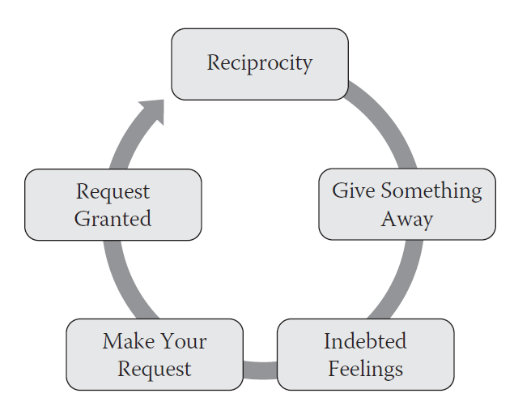
Reciprocation As mentioned, social engineers must practice the skill of persuasion until it becomes part of their everyday habits.

Slide 6

Scarcity People often find objects and opportunities more attractive if they are rare, scarce, or hard to obtain.

Slide 7
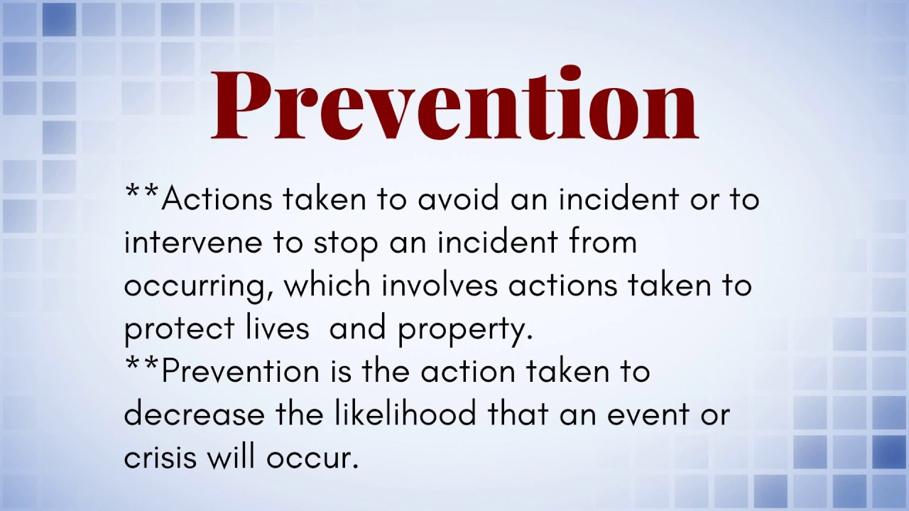
Prevention and Mitigation The stage in social engineering prevention and mitigation is to learn about the attacks.

Slide 8

Being Aware of the Value of the Information You Are Being Asked For You must realize the value of the data that you have and be aware of a tactic a social engineer might use to reduce the value of this information in your eyes.

Slide 9

Conclusion
Summing up, I want to say that in order not to fall into the trap of social engineers, you must firstly know their techniques and just be careful

Slide 10


